Slide 1
The Home Electrical System

Slide 2
Safety
Safety glasses or goggles should be worn whenever power tools are used, especially if you wear contact lenses.
Make sure the power is off at the breaker box before doing any electrical work
Always work in a clean, dry area free from anything wet.
Wires should only be connected at accessible junction boxes. Never splice wires together and conceal them within a wall without a junction box.
Never attempt to strip wires with a knife. Aside from endangering your fingers, you will nick the wire metal, which will create an electrical hazard.
Ground fault circuit interrupter outlets should be used under damp conditions (basements, bathrooms, outdoors, etc.), as required by the National Electric Code.

Slide 3
Safety Contd.
Replace wiring that shows signs of fraying or deterioration.
Avoid breaking your knuckles by bracing the powerful right-angle drill so that it cannot spin around if it gets stuck while drilling.
Before working with wires or electrical connections, check them with a voltage tester to be sure they are dead.
Plumbing and gas pipes are often used to ground electrical systems. Never touch them while working with electricity.
Don't use metal ladders with over- head electricity.
Use the proper protection, take precautions, and plan ahead. Never by-pass safety to save money or to rush a project

Slide 4
How does DC work

Slide 5
Useful Terms
Ampere. Measures the number of electrically charged particles that flow past a given point on a circuit (per second).
Breaker box (breaker panel). Houses the circuit breakers or fuses, distributes power to various parts of your house.
Circuit. All wiring controlled by one fuse or circuit breaker.
Circuit breaker. Protective device for each circuit, which automatically cuts off power from the main breaker in the event of an overload or short. Only a regulated amount of current can pass through the breaker before it will "trip."
Fish tape. A long, flexible metal strip with a formed hook (to which you fasten the cable) or wire to pull through walls, raceway, or conduit.
Main breaker. Turns the power entering your home through the breaker box on or off. This is sometimes found in the breaker box, or it may be in a separate box and at another location.

Slide 6
More Useful Terms
Neutral bus bar. The bar to which the neutral wire is connected in the breaker box.
Roughing-in. Placement of outlets, switches and lights prior to actual electrical hook-up.
Volt. Measures the current pressure at receptacles and lights. Average household voltage is 120.
Watt. The rate at which an electrical device (light bulb, appliance, etc.) consumes energy Watts=volts x amps.

Slide 7
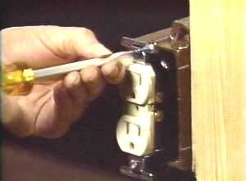
Roughing In
Junction boxes for outlets, switches, and lights are "roughed in" before the fixtures themselves are installed.
Tip: If the box you wish to extend from has reached its capacity and you cannot find a second one from which to run the new cable, simply replace the box with a larger and deeper one.

Slide 8
Basic Knowledge
There are basic rules to follow when installing receptacles on a wall.
The minimum height from the floor should be 15” from the center of the box.
Light switches should be 42” from the bottom
no more than 12-feet apart -with no point along a wall being more than 6-feet from a receptacle.

Slide 9
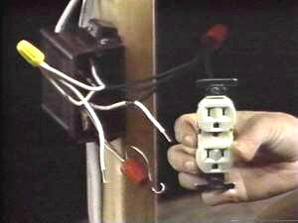
Placing The Boxes
Choose the correct junction boxes (where two or more wires are joined together) for your needs. Check your electrical code for local recommendations. They should be (UL approved and have the right dimensions to hold the wiring, outlets, and connectors you will be using.
Use a ruler or other object of appropriate length (screwdriver) to rest the boxes on when establishing installation points. Assure that your boxes will be flush with final wall covering by holding a small piece of the covering (i.e., drywall or paneling material) between the box and wall stud while attaching the box. Check code for height at which to install switch boxes.
Remove the knock out (s) in each box in the direction of the most efficient route for the cable to run.

Slide 10
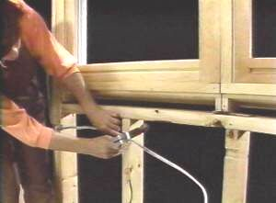
Stud Preparation
Drilling with a right-angle drill and an auger bit is the most common way to run the wire through interior, un-insulated walls. Some of the larger drills have right-angle attachments, or you can rent a right-angle drill from a local tool rental establishment.
Drill your holes dead center in the studs. Brace yourself and the cumbersome drill so that it does not spin around if it binds.
Notching rather than drilling the studs works best when you have insulation you don't want to compress. To notch,
Use a chalk line to snap two lines 1" apart across the studs. These will indicate the path the wire will follow.
Use a circular saw set to cut 1/2" notches at those lines on each stud.
Then use a chisel to carefully remove those blocks.
After placing the cable, cover the notches with nail guards to prevent accidental nailing into the wire.

Slide 11
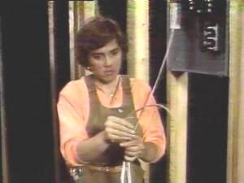
Wire Installation
Local and national codes require wire that is insulated and is the most efficient size for the appropriate application. The most commonly used interior wiring is a 12 or 14-gauge NM (nonmetallic) sheathed cable, sometimes called "Romex." Within the cable are plastic-coated copper wires, colored for each function.
Hot wires, usually black (sometimes red or blue), carry the power. Neutral wires, usually white, return the power. Grounding wires of bare copper (sometimes green or green and yellow) provide a path to the ground when an electrical failure occurs.
Beginning at the breaker box, expose enough wiring to reach the breaker switch and neutral bus bar. Use a cable stripper to prevent cutting the plastic coating on the wires.

Slide 12
Wire Installation (Cont’)
Knock out a box tab that will provide a direct route to the switch for the wiring. Knock out the tab at the junction box that provides the closest connection for each separate cable. Pull the wire and secure with a cable connector. Make sure that only the uncut sheathing is clamped at this opening.
Splice the cable back far enough to allow at least 6" of lead wire to stick out of the face of the box.

Slide 13
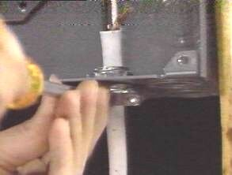
Wire Installation (Cont’)
Push the wire through each hole and roll the wire within the notches of the studs, keeping the wire smooth and free from kinks. Secure it with horseshoe nails at the notches. Local code will tell you how close to the junction box the first horseshoe nail must be (usually 8"), and how often the wire must be supported (usually every 4 1/2')
If, for any reason, you find that a wire does not reach from one junction box to another, do not tape two wires together to make it longer. Separate wires should only be connected at junction boxes that will be placed in the wall. It is a good idea, and often required by code, to make these junction boxes accessible by placing a solid cover-plate over a junction that will not make use of a receptacle. Try to play it safe and use a wire that is long enough to reach.

Slide 14
Wire Installation (Cont’)
Provide at least 6" of wire to spare at each end. Local code may vary on this length, so be sure to check. It is a good idea to label both ends of each wire with colored tape so you can always determine where it leads.
Where there is less than 1 1/4" between the face of the stud and the wiring, nail guards should be placed on the studs to protect the wire from any nails or screws that will attach the wall covering.
Now it is time to call in the inspector to check your work, before you complete the connections.

Slide 15
Tools Required
Long-nose pliers
Wire cutters
Electric drill
Tape measure
Screwdriver
Chalk line
Hammer
Circular saw
Chisel Hacksaw
Combination square
Utility light
Fish tape
Cable stripper
Wire stripper
Colored tape
Voltage tester
Continuity tester
Safety glasses or goggles
Keyhole saw
Utility knife
Right-angle drill
Pry bar and wood wedge

Slide 16
Materials Required
Grounded receptacles
Switches Rectangular junction boxes
Octagonal or circular junction boxes
Square junction boxes
Nail guards
Wire nuts
Horseshoe nails
Push terminals
Breakers
Track lights and fittings
Dimmer switch
Waterproof junction boxes
Ground fault interrupters
Conduit
Cable Silicon caulking

